Slide 1
Welcome to MetroTex!

Slide 2
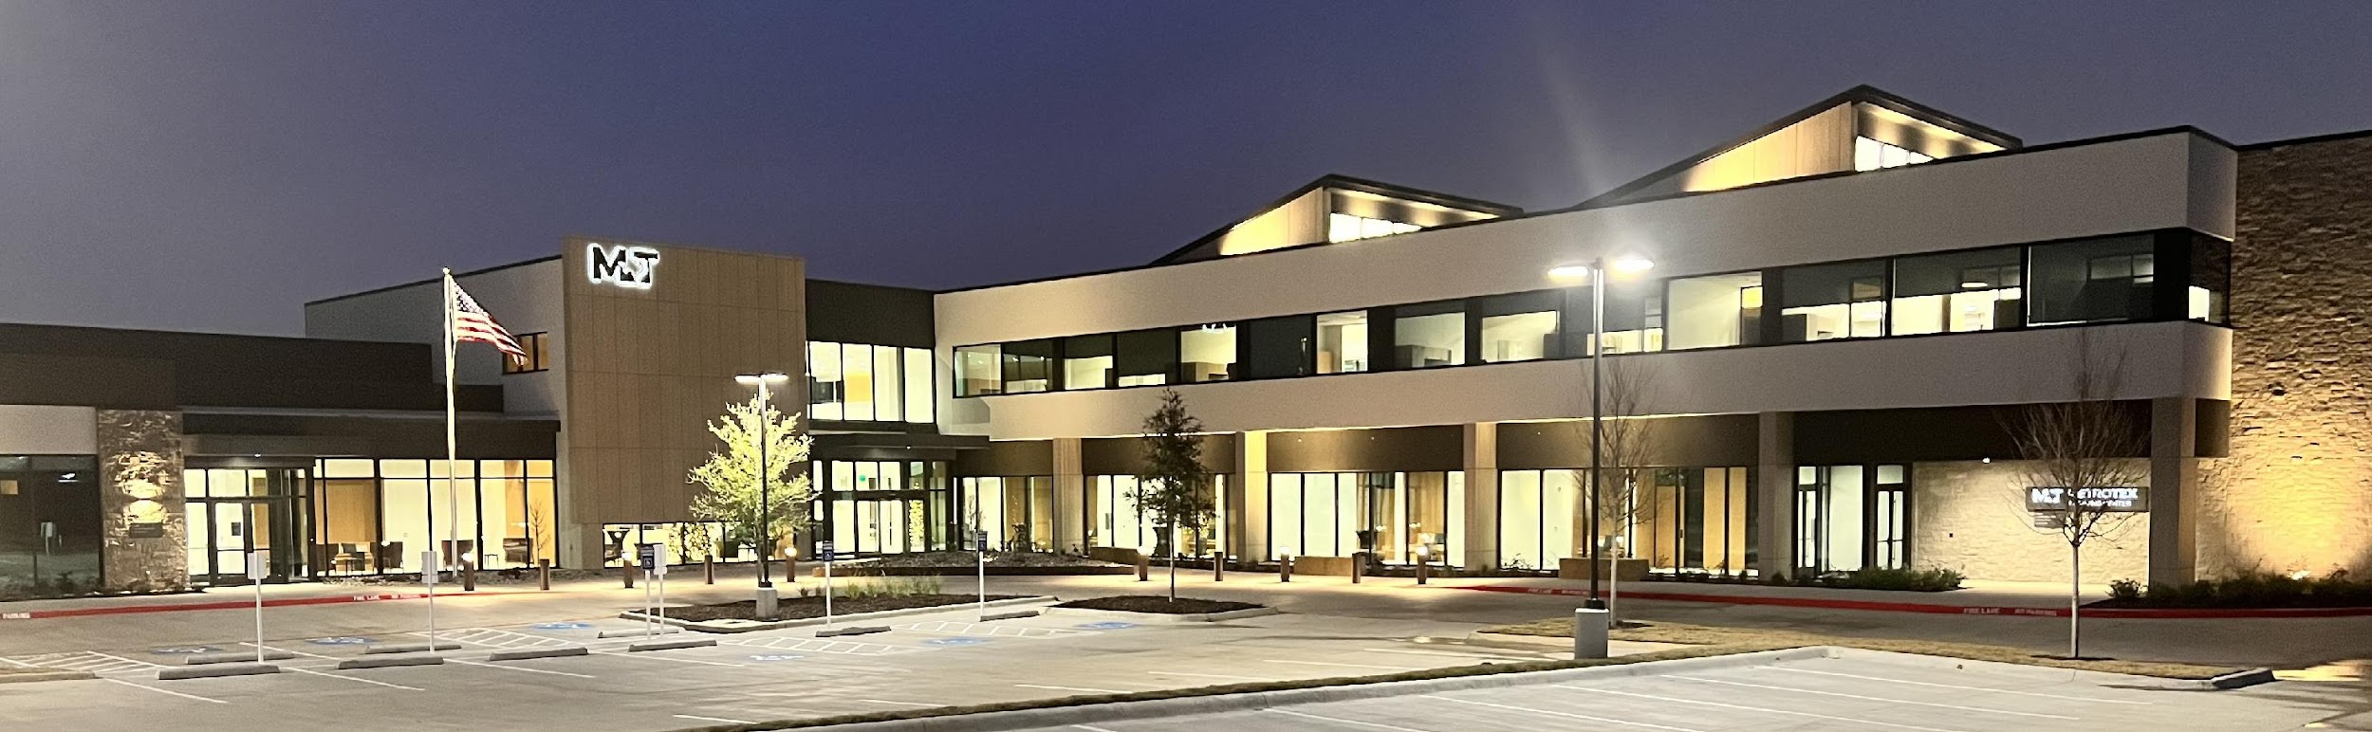


Who Are We?
MetroTex Association of REALTORS®
Established 1917
Over 36,000 members
Multiple locations across the metroplex

Slide 3









Let’s Connect!
Follow us on:
www.metrotex.com
portal.metrotex.com

Slide 4

Contact Us
Member Services membership@metrotex.com
MLS Department mls@metrotex.com
Tel: 214.637.6660
Fax: 214.637.5951
MetroTex Irving HQ
1701 Kinwest Pkwy Irving, TX 75063
Office Hours:
8:30 a.m. – 5:00p.m.* Monday – Friday
MetroTex Plano 6821 Coit Road
Plano, TX 75024
Accounting accounting@metrotex.com
Professional Development professionaldevelopment@metrotex.com
* Some offices close from noon to 1:00pm daily. Details at metrotex.com/locations.

Slide 5
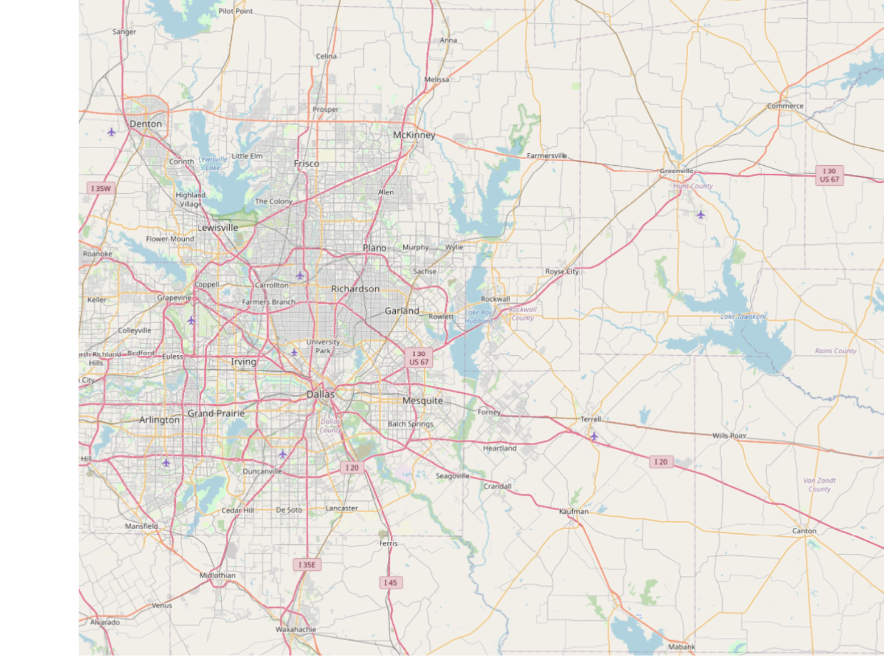

Locations

Slide 6

Area Meetings

Slide 7
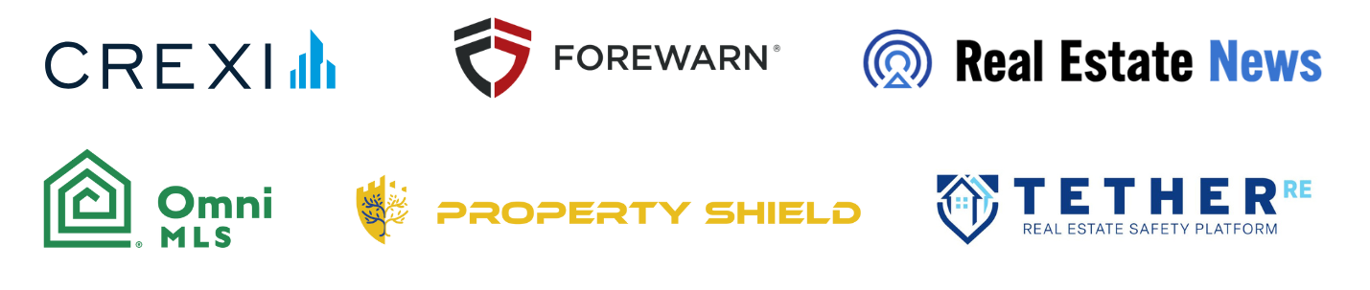




Featured MetroTex Benefits

Slide 8

MLS & Key Services

Slide 9
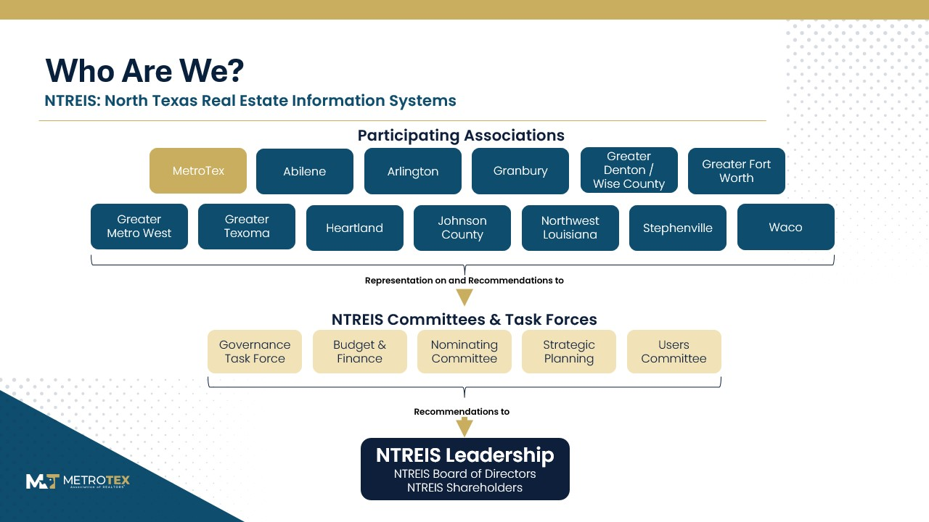

Slide 10
Objectives
1
2
3
4
MLS Products
Important MLS Rules
Services /
Tools
Communications
Channels

Slide 11
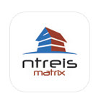





Your MLS Products
Matrix
zipForm
Instanet
Realist Tax
RPR
Cloud Suite
Your MLS system
Use on any browser on PC or tablet
All-in-one transaction management system provided by Texas REALTORS®
Approved forms just a few clicks away
Access and manage all forms, contracts, and documents
Use any computer with internet access
Tax data from all counties in Texas
Census reports, school information, mailing labels, and foreclosure activity
Comprehensive data, powerful analytics, and client-friendly reports
Created by NAR and 100% owned by REALTORS®
Cloud CMA, Cloud MLX, and Cloud Streams
Convenient alternative to the main MLS system

Slide 12
Clear Cooperation Policy
Within one (1) business day of marketing a property to the public, the listing broker must submit the listing to the MLS for cooperation with other MLS participants. Public marketing includes, but is not limited to, flyers displayed in windows, yard signs, digital marketing on public facing websites, brokerage website displays (including IDX and VOW), digital communications marketing (email blasts), multi-brokerage listing sharing networks, and applications available to the general public. (Adopted 11/19)

Slide 13




Data Input Sheets
Residential Data Input Sheets
Take on Listing Appointment
Access via Instanet, upload to Matrix
Satisfy MLS Rules 7.07 and 7.26
Ensure Accuracy of Information

Slide 14
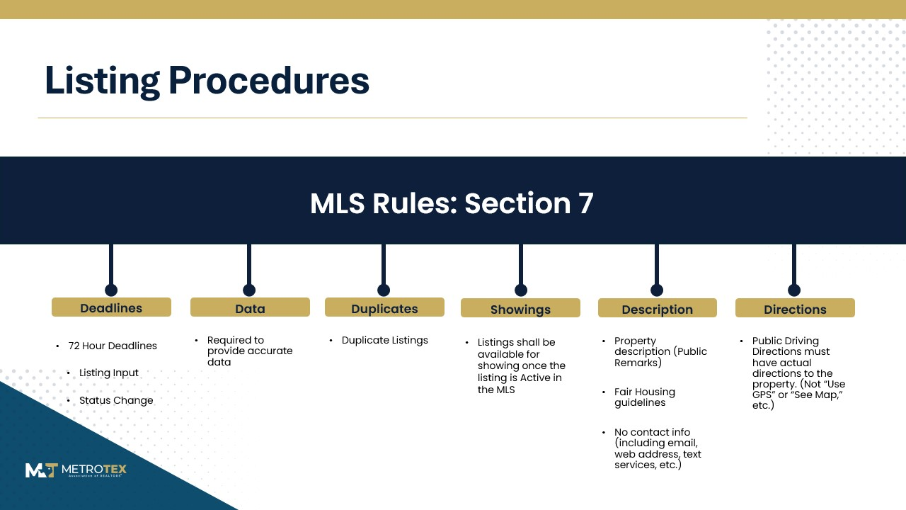

Slide 15
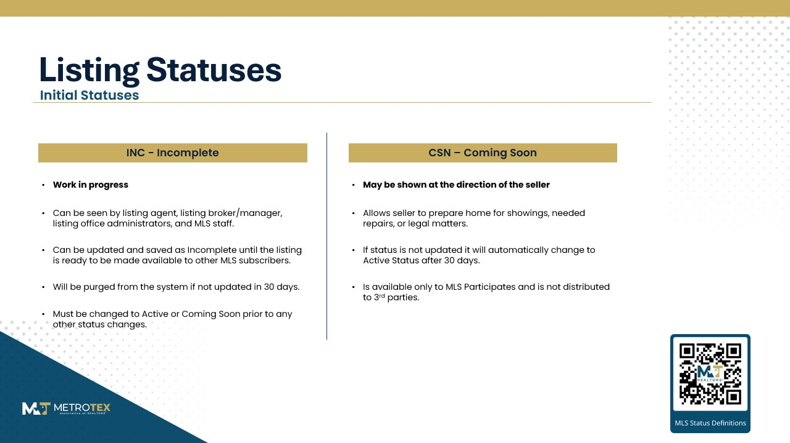

Slide 16

Listing Statuses
Active Statuses
ACT - Active
AKO – Active Kick Out
Must be available for showings.
Will expire on the expiration date entered by the agent.
Still available for showings.
Seller has accepted an offer contingent upon sale of another property by the Buyer.
Will expire on the expiration date entered by the agent.
AC – Active Contingent
AOC – Active Option Contract
Still available for showings.
Seller has accepted an offer but will entertain backup offers.
Will expire on the expiration date entered by the agent.
Still available for showings.
Seller has accepted an offer but Buyer is exercising the option period from the sales contract.
Will expire on the expiration date entered by the agent.

Slide 17
Listing Statuses
Final Statuses
PND - Pending
H - Hold
Property has an offer with no contingencies, Kick Outs, or options.
Does not expire.
Property is temporarily unavailable for showings.
Listing agreement still in place and will expire on original expiration date entered by agent.
.
WTH - Withdrawn
EXP - Expired
No longer available for showings.
Cannot be relisted with another broker. Will expire on the original expiration date entered by agent.
Listing Has Expired.
CAN - Cancelled
C – Closed
No longer available for showings.
Seller is free to relist with another broker.
Listing has sold or leased.

Slide 18



Listing Distribution
Distribution of listings to Realtor.com and 3rd party sites are handled by NTREIS.
Distribution is a decision made by the Broker or Seller.
Listings are also distributed to more than 750 other websites via List Hub.

Slide 19
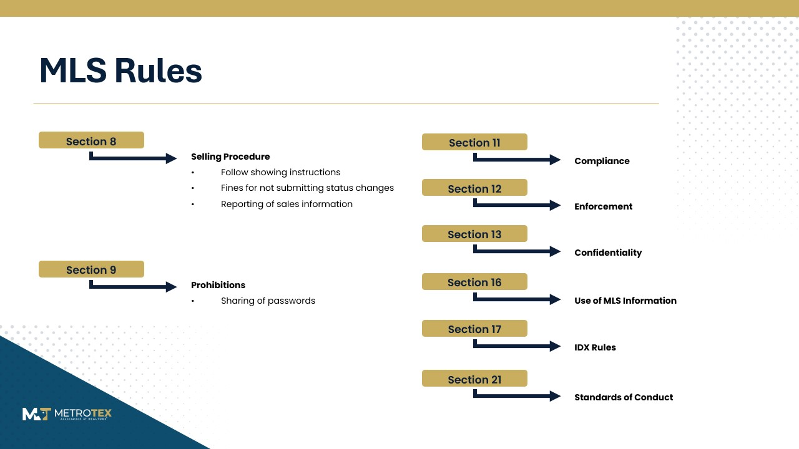

Slide 20
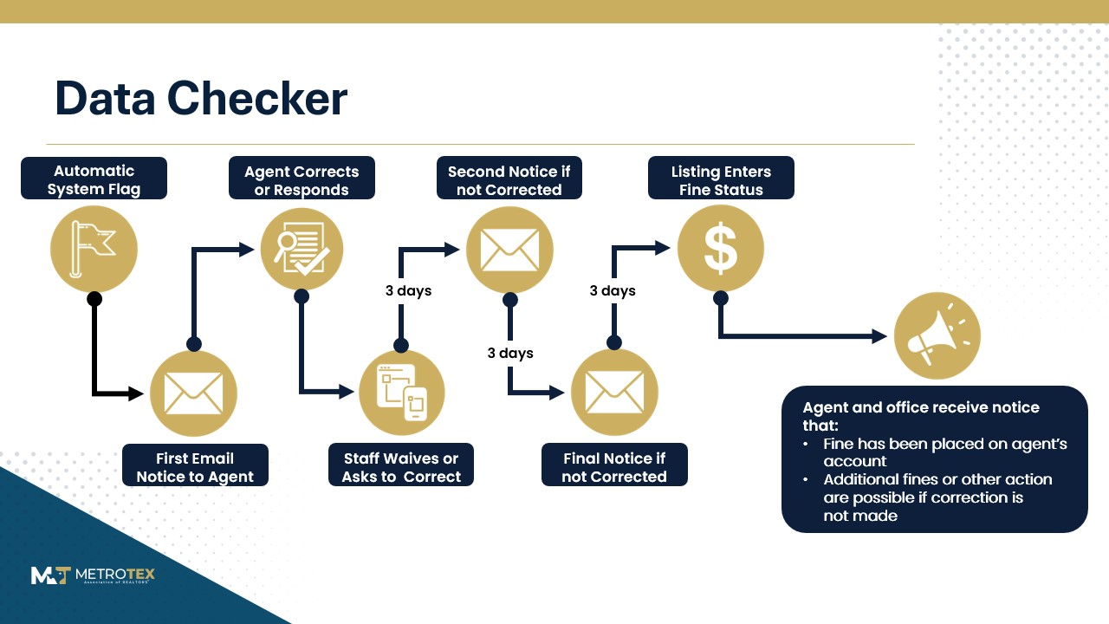

Slide 21
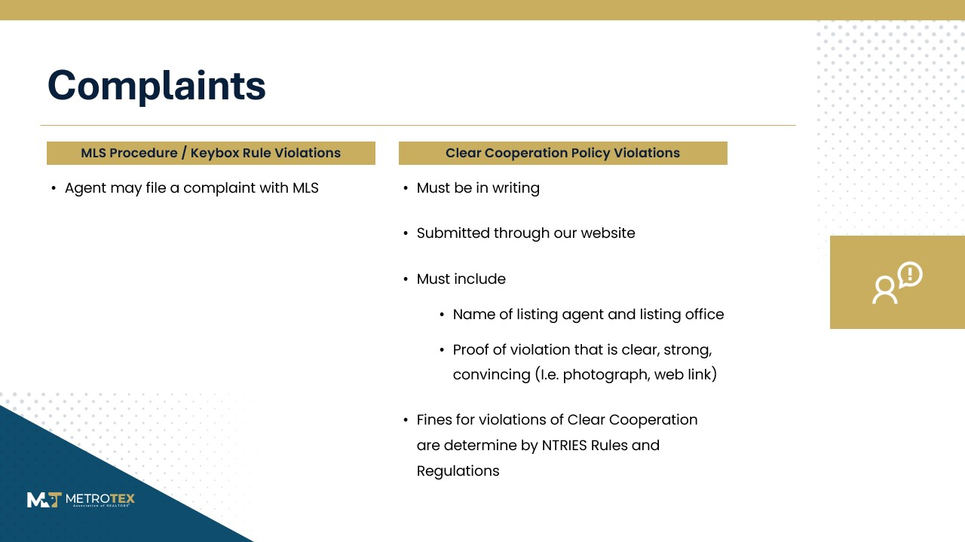

Slide 22
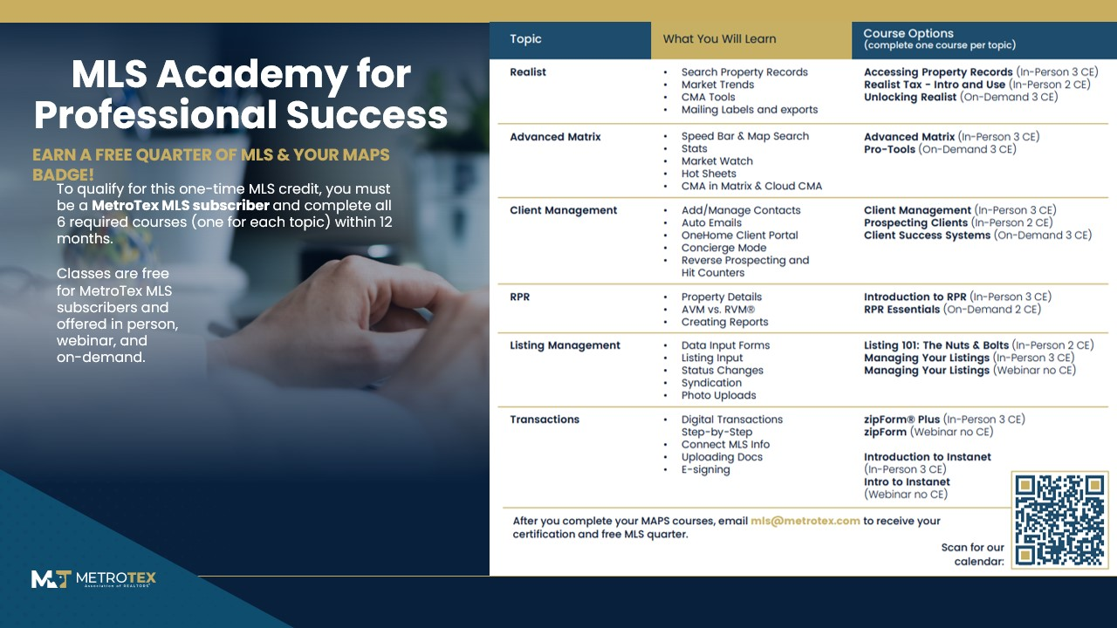

Slide 23


Clases de MLS en español
¿Alguna vez ha deseado poder aprender más sobre MLS en una clase en español? ¡Ahora puede hacerlo!​
Las clases de español de MLS estarán disponibles durante el año con un instructor que habla español.

Slide 24
MLS Communication
Newsletters mentioned earlier
MLS Training Classes
Matrix Landing Page news and alerts
Clarity Dashboard
Meetings: Area Meetings and Office Meetings
Social Media
Automatic communications from Data Checker

Slide 25
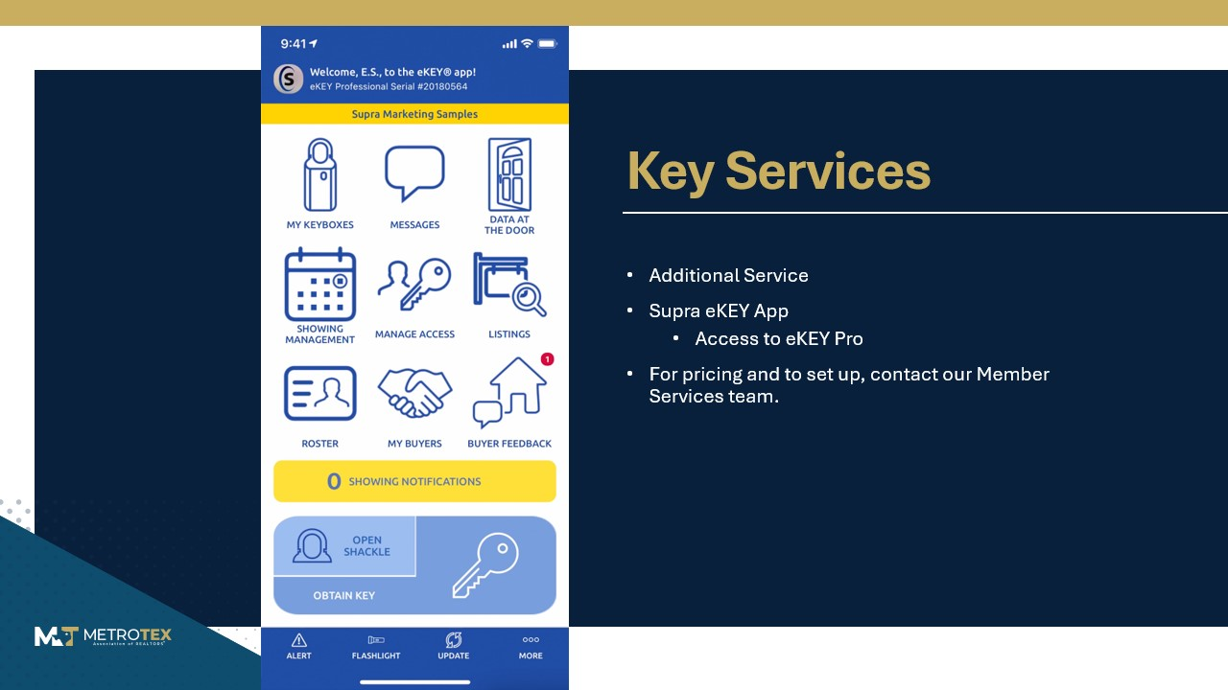

Slide 26
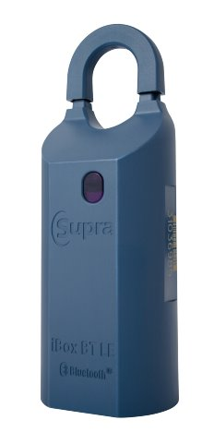
Keyboxes
Keyboxes sold separately at $129.90 each
Available at all MetroTex locations
BTLE, Bluetooth
Access keybox and activity reports through:
supraekey.com

Slide 27


Vendor Contact Information
For after hours technical support:
Matrix & Transaction Desk Monday – Friday, 7am – 12am Saturday – Sunday, 10am – 10pm 800.297.6367
zipForm Monday – Friday, 6am – 10pm 800.383.9805
Supra Monday – Sunday, 8am – 9pm 877.699.6787

Slide 28
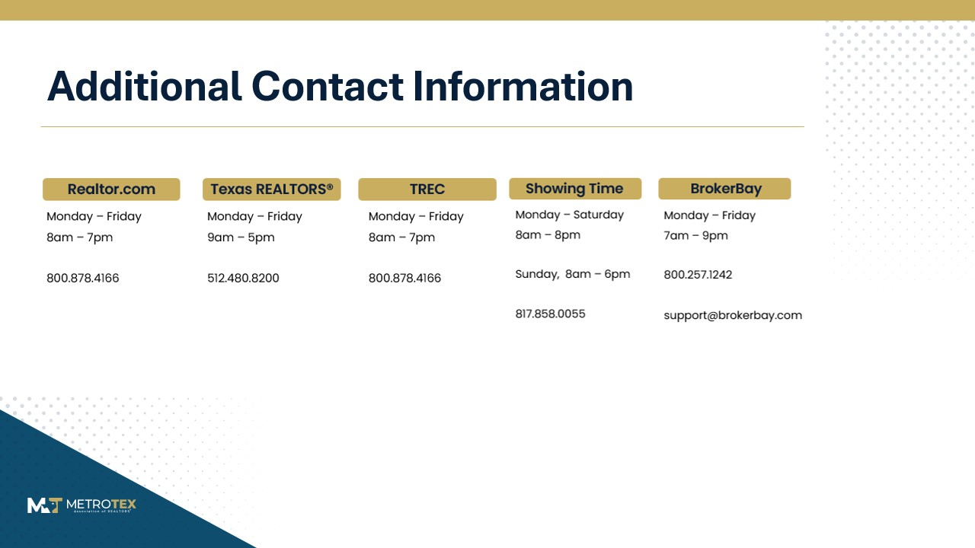

Slide 29

Questions?

Slide 30

Government Affairs & TREPAC

Slide 31

TREPAC FAQs
How does TREPAC affect real estate?
Where do TREPAC dollars go?
How can REALTORS® support TREPAC?
Which political party does TREPAC support?
Government’s role in real estate is steadily increasing at all levels. To maintain a healthy climate for real estate in Texas and preserve real property rights, Texas REALTORS® must participate in the political process through TREPAC.
All funds eligible to be invested in pro-real estate candidates running for political office are expended for that purpose.
Your TREPAC investment helps put pro-real estate candidates in office to protect your livelihood and profession. In return for TREPAC’s hard work, we ask that you invest your fair share of $50.
WE ARE THE REALTOR® PARTY; TREPAC is not affiliated with any political party. The program and platform of the individual candidates, board recommendations, and ultimate action by TREPAC trustees determine who TREPAC supports—not the candidate’s party affiliation.

Slide 32
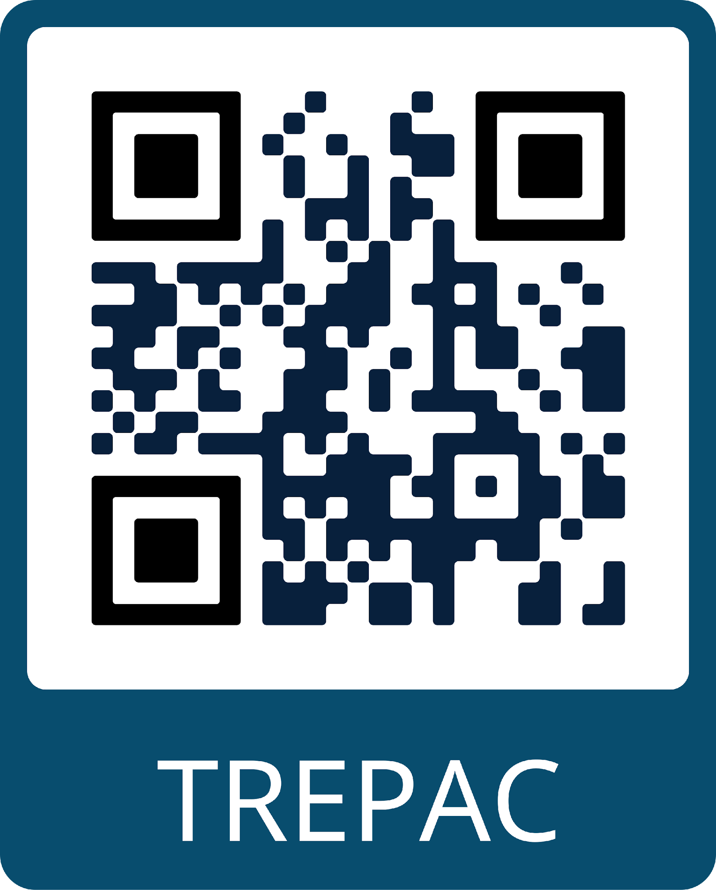
TREPAC Disclaimer
CONTRIBUTIONS ARE NOT DEDUCTIBLE FOR FEDERAL INCOME TAX PURPOSES. CONTRIBUTIONS TO THE TEXAS REALTORS® POLITICAL ACTION COMMITTEE (TREPAC) ANDTHE TEXAS ASSOCIATION OF REALTORS® FEDERAL POLITICAL ACTION COMMITTEE (TAR FEDPAC)—WHICH MAKES CONTRIBUTIONS TO THE REALTORS® POLITICAL ACTION COMMITTEE (RPAC)—ARE VOLUNTARY AND MAY BE USED FOR POLITICAL PURPOSES. THE AMOUNT INDICATED IS MERELY A GUIDELINE, AND YOU MAY CONTRIBUTE MORE OR LESS THAN THE SUGGESTED AMOUNT. YOU MAY REFUSE TO CONTRIBUTE WITHOUT REPRISAL, AND THE NATIONAL ASSOCIATION OF REALTORS®, TEXAS REALTORS®, AND ITS LOCAL ASSOCIATIONS WILL NOT FAVOR OR DISADVANTAGE ANYONEBECAUSE OF THE AMOUNT CONTRIBUTED. UNTIL THE RPAC ANNUAL GOAL IS MET, 70% OF AN INDIVIDUAL’S CONTRIBUTION GOES TO TREPAC AND MAY BE USED TO SUPPORT STATE AND LOCAL CANDIDATES; THE REMAINING 30% IS SENT TO TAR FEDPACTO SUPPORT FEDERAL CANDIDATES AND IS CHARGED AGAINST YOUR LIMITS UNDER 52 U.S.C. 30116. (EXCEPTION: 100% OF AN INDIVIDUAL’S CONTRIBUTION GOES TO TREPAC IF THE INDIVIDUAL IS AN EMPLOYEE OF AN AFFILIATE MEMBER OF TEXASREALTORS®.) AFTER THE RPAC ANNUAL GOAL IS MET, 100% OF AN INDIVIDUAL’S CONTRIBUTION GOES TO TREPAC AND MAY BE USED TO SUPPORT STATE AND LOCAL CANDIDATES. YOU MAY CONTACT THE TEXAS REALTORS® POLITICAL COMMITTEE ADMINISTRATOR AT 800-873-9155 TO OBTAIN INFORMATION ABOUT YOUR CONTRIBUTIONS.

Slide 33

Professional Development

Slide 34



The REALTOR® Family
Local
State
National
Your REALTOR® Membership

Slide 35



Benefits from NAR and Texas REALTORS®
Financial Solutions
Texas REALTORS® Legal Hotline: 512-480-8200
Home & Auto Insurance
Risk Management
Office & Business Solutions
Technology & Wireless Solutions
Automotive, Travel, & Entertainment Solutions
And more!

Slide 36

NAR Education Requirements
Two courses must be completed in Cycle 8 (Jan. 1, 2025 – Dec. 31, 2027)
Code of Ethics* Completed by Orientation or The NAR Code of Ethics course
Fair Housing Completed by NAR’s online Fair Haven course, AHWD, or Bias Override

Slide 37

What About TREC?
State government agency
Licensing
Regulation and enforcement

Slide 38

TREC Education Requirements
During your FIRST TWO YEARS of licensure, TREC requires you take a total of 98 hours of Sales Apprentice Education (SAE).
3
30-hour SAE courses*
2
Four-hour Legal courses
98
Total SAE hours
+
=

Slide 39


Graduate REALTOR® Institute (GRI)
To earn the GRI Designation, all three parts of the program must be completed.
Contracts to Close
Business Skills
Brokerage
Seller Services
Buyer Services
Real Estate Technology
Environment and Green Building
Finance and Lending
Residential Contracts
Appraisals, CMAs, and Pricing
Diversity and Fair Housing
Professional Standards
Policies and Procedures
Brokerage and Agency Relations
Business Development
Get more details here!

Slide 40






Commercial Program
Delivering exceptional education, unparalleled networking opportunities, and comprehensive resources to empower MetroTex members excelling in the field of Commercial Real Estate. Our commitment is to support industry professionals with cutting-edge tools and insights that drive success in a
competitive market.
Learn more about the Commercial Program!

Slide 41

Texas Accredited Commercial Specialist (TACS)
To earn the TACS Designation, all three parts of the program must be completed.
TACS 1
TACS 2
TACS 3
Intro to Commercial Real Estate
Commercial Real Estate Property Development
Commercial Real Estate Marketing & Negotiation
Get more details here!

Slide 42




Global Program
The mission of the MetroTex Global Business Council is to provide a collaborative system of information, resources, networking and skills training for all members. These services will enhance legal, diverse cultural and business protocol awareness of the global real estate environment.
Learn more about the Global Program!

Slide 43



Global & Diversity Education
Certified International Property Specialist
At Home with Diversity
Resort & Second Home Property Specialist
The CIPS designation requires completion of five full-day courses focusing on the critical aspects of international real estate transactions. CIPS designees are connected to an influential network of over 3,500 professionals who turn to each other first when looking for referral partners.
The course work for this certification is designed to enable you to work successfully with and within a rapidly changing multicultural market. It will help you to learn diversity sensitivity, how it applies to U.S. fair housing laws in your business, and ways to develop professional guidelines for working with people in the increasingly multicultural real estate market.
This certification is designed for REALTORS® who facilitate the buying, selling, or management of properties for investment, development, retirement, or second homes in a resort, recreational and/or vacation destination are involved in this market niche.

Slide 44



Volunteer Opportunities
Texas REALTORS® Leadership Program
Association Committees
Area Meeting Representatives
Mentorship Program
Learn more about how you can get involved!

Slide 45


Global Program
ProgramThe mission of the MetroTex GlobalBusiness Council is to provide acollaborative system of information,resources, networking and skills trainingfor all members. These services willenhance legal, diverse cultural andbusiness protocol awareness of theglobal real estate environment.
Learn more about the Global Program!

Slide 46
Questions?

Slide 47
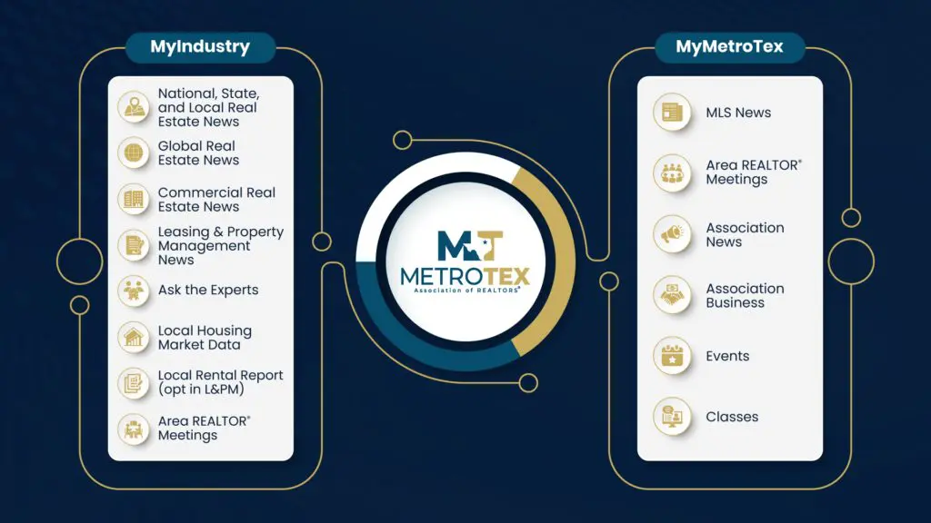
MetroTex e.News
Two newsletters each week:
Wednesday: Industry focused
Friday: MetroTex focused

Slide 48
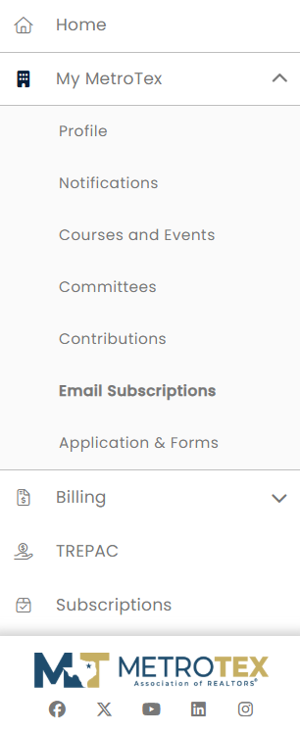


Update Your Communication Preferences
Open the “My MetroTex” tab in your Member Portal
Select “Email Subscriptions”
Choose which categories you would like to receive email communications for by toggling them on or off
Please note that you cannot unsubscribe from important system emails. These include billing emails and critical account information.

Slide 49






Billing & Payments
Made Easy
Member Portal
Manage your account anytime
Billing Calendar
Stay on top of deadlines
AutoPay
Hassle-free payments
Scan to Get Started

